Slide 1
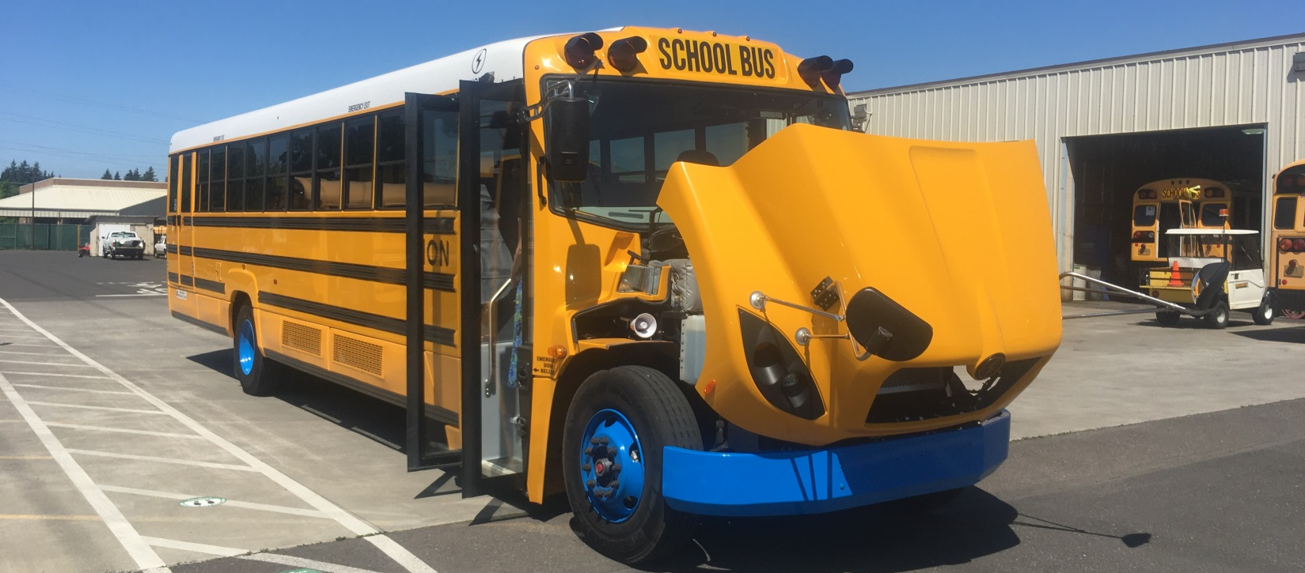
How to Fund an Electric Bus?
July 7th, 2021
Brought to you by the Electric Bus Learning Project
Envirocenter.org/Electric-Bus

Slide 2
Electric Bus Learning Project
Alison Wiley
Project Manager
Western and Southern Oregon
541-295-0255
alison@electricschoolbus.org
Neil Baunsgard
Project Coordinator
Central and North East Oregon
425-765-2602
Neil@envirocenter.org
• Online forums
• Trainings
• Personalized consultations
• Site visits
• Free of charge
• Peer-to-peer support network
• Support in finding funding

Slide 3
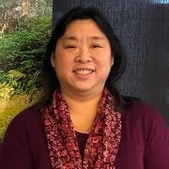
Next Up
Oregon Clean Fuels Program and Advanced Crediting
Cory-Ann Wind
Oregon Clean Fuels Program Manager
Oregon Department of Environmental Quality
Notes:
Cory-Ann Wind works for the Oregon Department of Environmental Quality as the Oregon Clean Fuels
Program Manager. Cory has worked for ODEQ for over 28 years, the last 11 in fuels, transportation, and
climate policy. Cory holds a B.S. in BioResources Engineering from Oregon State University.

Slide 4

Clean Fuels Program Update
Electric School Bus Funding in Oregon
July 7, 2021
Cory-Ann Wind, Clean Fuels Program Manager
Office of Greenhouse Gas Programs – Oregon Clean Fuels Program
Notes:
Colin to start :
Why we are here – consider rules to make targeted adjustments to how the Clean Fuels Program incentivizes one important clean fuel: electricity
Back-up – what the Clean Fuels Program is at a very high level:
One of Oregon’s most important programs to address our state’s greenhouse gas emissions
Requires reductions of pollution from Oregon’s most significant source: transportation fuels
Mandates a 10% lifecycle reduction over 10 years
Fuels/technology agnostic
Include TP about relation of CFP to diesel pollution
Hand it over to Cory, but before I do that I want to acknowledge the significant work that Cory and her team have done to quickly develop these proposed rules all while running this program concurrently. We have an incredibly talented and passionate team running this program, and they all chipped in to help with this important task. In addition to Cory, our Clean Fuels Team includes:
Bill Peters
Stephanie Summers
Kiara Winans
With that, I’ll hand it over to Cory-Ann Wind to provide the Commission with a bit of an update on the Clean Fuels Program – what it is, and where it is at, before she dives into the heart of this agenda item, which are proposed changes to the Commission’s rules governing how this program treats electricity as a clean transportation fuel
Good morning Chair George and commissioners, for the record, my name is Cory-Ann Wind and I am the Clean Fuels Program Manager. It is my pleasure to present to you today an update of the program and our latest rulemaking effort for your consideration.

Slide 5
Clean Fuels Program in a Nutshell
Mandatory Fuels
  Gasoline
  Diesel
  Ethanol
  Biodiesel
  Renewable diesel
Voluntary Fuels
  Fossil and renewable CNG
  Fossil and renewable LNG
  Fossil and renewable LPG
  Sustainable aviation fuel
  Electricity
  Hydrogen
Deficit Generation
2015
2020
2025
2030
2035

Slide 6
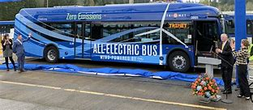
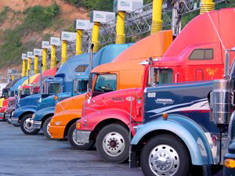
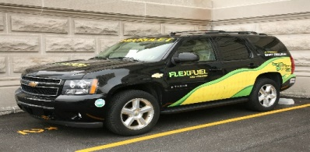
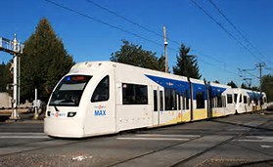
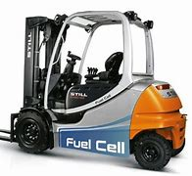
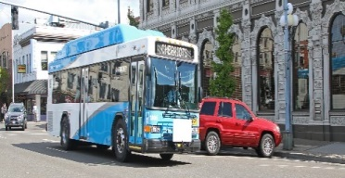
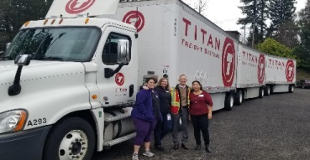
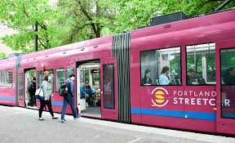
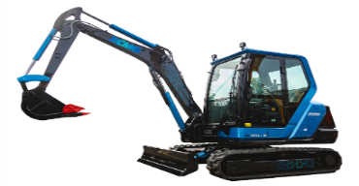
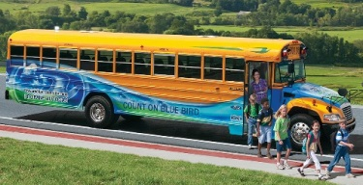
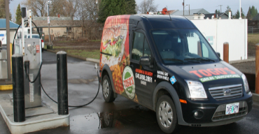
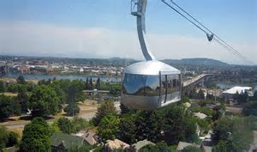
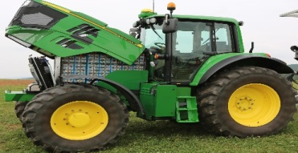
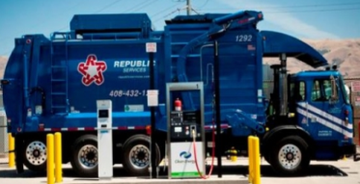
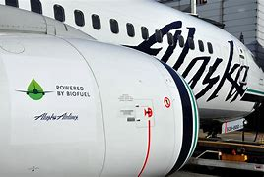
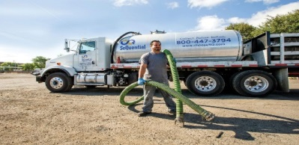
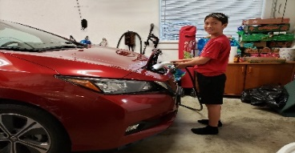
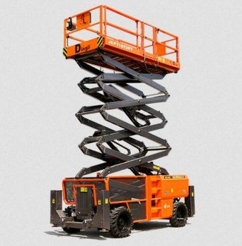
Types of Clean Fuels and Applications
  Ethanol
  Biodiesel
  Renewable diesel
  Fossil and renewable CNG
  Fossil and renewable LNG
  Fossil and renewable LPG
  Sustainable aviation fuel
  Electricity
  Hydrogen

Slide 7
Credit Generators for Electricity
 | Base Credits | Incremental Credits
Public, workplaces, fleets, and multi-unit dwellings | Owner or operator of the charger | Owner or operator of the charger
Transit agencies | Transit agency | Transit agency
Forklifts, transportation refrigeration units, cargo handling equipment, ocean-going vessel shorepower | Owner/operator/ service provider | Owner/operator/service provider
Residential | Electric utility | Electric utility
 | Backstop Aggregator | Incremental Aggregator
Notes:
So this chart shows who can generate the electricity credits in the Clean Fuels Program. We are proposing that for the most part, the parties that generate the base credits will also be eligible to generate the incremental credits. The exception would be for the residential charging. For the base credits, the electric utility can opt in to generate those credits and the unclaimed credits go to a third-party Backstop Aggregator. The current Backstop Aggregator is the Forth Mobility Fund and they have worked with DEQ for the past 3 years to fund programs and projects to expand awareness about electric vehicles. For the incremental credits, the electric utility can also opt in to generate those credits and the unclaimed credits would go to a new entity called an Incremental Aggregator.

Slide 8
Advanced Crediting
Regular credit generation occurs on a quarterly basis when the credit generator submits their quarterly report about how much electricity was dispensed from a charger.
Electric vehicle placed into service
Credits
Credits
Credits
Credits
Credits
Credits
Advanced Crediting (up to 6 years)
Payback Period (up to 3 years greater than the advanced credits were approved for)
Regular Crediting
Advanced crediting is when DEQ grants up to 6 years’ worth of credits when the first electric vehicle is placed into service.
Notes:
The last theme that I want to cover is that Clean Fuels Program should be designed to incentivize the electrification of medium and heavy duty fleets. We are proposing a new provision that we are calling advanced crediting whose aim is to create an incentive to speed up the transition of a fleet and to offset the many costs that are associated with that.
In the current program, credits are generated on a quarterly basis when the fleet reports its electricity used to power its vehicles. DEQ is proposing to issue credits in advance of when they would normally be generated -- up to six years’ worth -- once the vehicle is put into service by estimating the amount of electricity to be used over that period of time. The entity can then sell those credits to offset its upfront costs or for additional EVs, thus creating a virtuous cycle of generating more credits for the program and more revenue for the fleet. The entity would then have up to nine years to pay back the credits that were advanced to them.
At this time, DEQ is proposing that advanced crediting be available only to public agencies such as port authorities, transit agencies, school districts, and fleets that contract with public agencies that provide a public service such as garbage trucks. This targeted approach is specifically designed to align with other DEQ efforts such as the Medium and Heavy Duty Zero Emission Vehicle Memorandum of Understanding and the Every Mile Counts Alternative Fuels Study. DEQ believes that this new provision will be a significant addition to the agency’s strategy to reduce diesel emissions.

Slide 9
Advanced Crediting: Example
In this example, the Newberg School District has received a grant from PGE for a new electric school bus and is interested in applying for advanced credits to help buy more. DEQ will work with the school district as it develops its application.
Year | Estimated |  |  | Revenue if credits sold @ $125
 | Miles | kWh | Credits
2022 | 15,000 | 27,900 | 36 | $ 4,498.64
2023 | 15,000 | 27,900 | 35 | $ 4,406.36
2024 | 15,000 | 27,900 | 35 | $ 4,314.08
2025 | 15,000 | 27,900 | 34 | $ 4,191.04
2026 | 15,000 | 27,900 | 34 | $ 4,191.04
2027 | 15,000 | 27,900 | 34 | $ 4,191.04
 |  |  | Total: | $ 25,792.19
Notes:
To illustrate how this provision would work, I’ve created an example using the Newberg School District who recently received a grant from Portland General Electric for its first electric school bus and will also be piloting the state’s first bus to grid demonstration project. This grant program is funded by the CFP credits that are generated by PGE on behalf of their residential EV-owning customers and Newberg is one of 4 school districts to be awarded an electric school bus along with Beaverton, Salem-Keizer, and Reynolds,. A PacifiCorp grant program will be funding an electric school bus for the Bend LaPine school district. And PGE and PacifiCorp partnered to fund an electric school bus for the Portland Public School District.
In this example, the Newberg School District wants to buy more buses so it wants to apply for this new advanced crediting provision to help bring down the associated costs of doing so. DEQ will work with the school district to estimate the amount of miles the electric school bus would be driven and the amount of electricity that would be used to charge it. This table contains six years of credit generation assuming 15,000 miles are driven per year and that it takes 27,900 kilowatt hours per year to charge. If the credits were sold at $125 per credit, approximately $25,000 of additional revenue could be generated when the school bus was placed into service rather than waiting for 6 years to generate those credits.

Slide 10
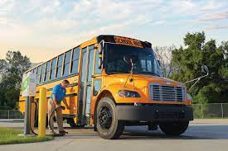
Advance Crediting: Who is Eligible?
Political subdivisions of the State of Oregon
Tribes
Public Transit Agencies
School Districts
Companies under contract to provide services to a political subdivision of the State of Oregon or an Oregon School District
Notes:
Advance crediting only applies to electric vehicles. Advance crediting is available only to public agencies such as port authorities, transit agencies, school districts, and fleets that contract with public agencies that provide a public service such as garbage trucks. Certain private entities, such as those under franchise agreements with public entities or that are on contract to provide an on-going service can also apply.
Companies under contract to provide services to a political subdivision of the State of Oregon or an Oregon School District such as
Contracted pupil transportation services
Garbage haulers under a franchise agreement with a local government

Slide 11
Advance Credits: Process
Application
Estimate the amount of electricity dispensed over a longer period of time
Agreement
Agree on how many credits will be advanced
Selling Credits
Sell credits within the Oregon Fuels Reporting System
Using Revenue
Payback
Next EV, chargers, worker training, shop upgrades, etc.
No longer than 3 years greater than the term for advanced credits
Notes:
DEQ will hold at least one application period each year
Public fleets can apply for advance crediting at specific time periods that DEQ establishes. This window will allow DEQ to evaluate multiple applications simultaneously in order to ensure that the amount of advance credits generated do not exceed the maximum threshold of 5% of total deficits generated in the previous compliance year.
DEQ will develop an application form to enable applicants to provide detailed estimates of how many credits would be generated over several years once that electric vehicle is put into operation. DEQ will work directly with potential applicants and provide calculators and other guidance for how to complete the calculations and determine a reasonable estimate.

Slide 12
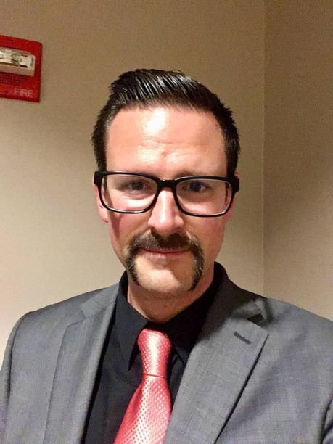
Next Up
Oregon Department Of Education
Brock Dittus
Operations and Policy Manager
Oregon Department of Education
Notes:
Brock Dittus is an Operations & Policy Analyst at Oregon Department of Education’s Pupil Transportation Unit. He has been involved in school transportation since 2007, when he started his career as a school bus driver at Portland Public Schools as a special needs route driver. He became an ODE certified Behind The Wheel Instructor and Core Instructor in 2015. In 2018 he accepted his current position, evaluating and assisting programs across Oregon in compliance and equitable service to their communities. When he’s not working, Brock enjoys music, bicycle exploration, and good coffee; he lives with his wife and two sons in Salem, Oregon.

Slide 13
State School Fund
Transportation Grant
Brock Dittus
Oregon Department of Education

Slide 14

The Grant
Estimate of Membership and Revenue > Reconciled with Actual Financial data and Pupil Transportation reports.
Largest Grant in the state school fund
  $235,663,797 - 19-20
  70, 80, 90 % reimbursement based on Cost per ADMr

Slide 15
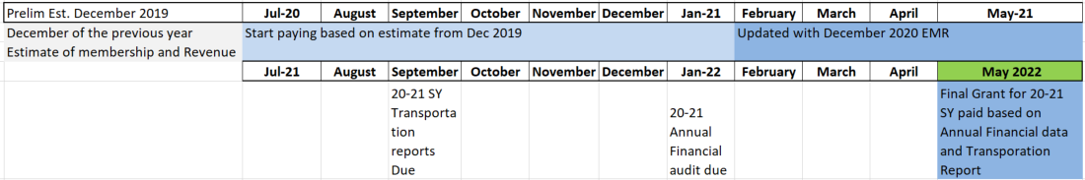
Life-cycle of Transportation Grant

Slide 16

Estimate of Membership and Revenue data collection

Slide 17
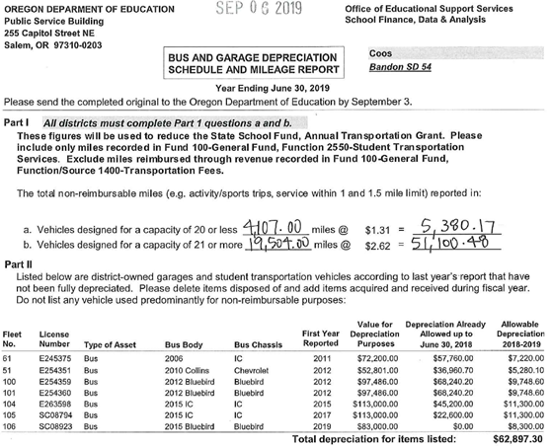
Pupil Transportation reports

Slide 18
Break down ADMr
Example: $500,000/250 ADMr = $2,000
Top 20 districts with the highest costs per ADMr receive 90%
Next 20 receive 80%
The 157 remaining districts receive 70%
Notes:
Districts report eligible transportation costs and then we divide by ADMr. We then take the cost per ADMr and rank the districts, those with higher costs per student are at the top and so on. This sets the rate 70, 80, or 90. That rate is then multiplied by eligible transportation costs to get the amount of the reimbursement.
It takes more funding for rural districts to provide the same level of service as a district along I5.

Slide 19
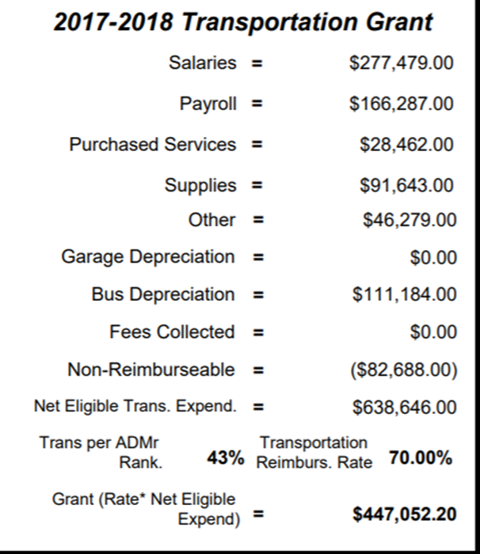
Transportation Grant
Financial Audit data
Transportation reports
Notes:
The transportation grant is eligible transportation costs divided by ADMr. You take that number and rank districts, this sets the rate as 70, 80, or 90. That rate is then multiplied by eligible transportation costs to get the amount of the reimbursement.
Have a discussion about how different districts track miles

Slide 20
Questions
State School Fund or Transportation Grant Questions:
Adam.Krein@ode.state.or.us
503-947-5678
Transportation reports, Form 581-3171 Bus and Garage Depreciation Schedule and Mileage Reports Questions:
Brock.Dittus@ode.state.or.us
buslicense@ode.state.or.us
503-947-5724

Slide 21
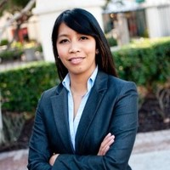
Next Up
Electric Mobility Grant – Pacific Power
Esther Pullido
Project Manager
Pacific Power
Notes:
Esther is a Project Manager at Pacific Power and supports the day to day administration of transportation electrification programs. Prior to Pacific Power, Esther had a diverse background in both the public and private sector. She started her career in sustainability at Enhabit supporting home efficiency and weatherization. Recently she's helped launch ReachNow's car share service in Portland and opened Forth's Electric Vehicle Showcase. She's passionate about transportation equity and working with BIPOC communities.
Esther holds a Bachelor's of Science degree in Geography and Regional Development from the University of Arizona.

Slide 22
Electric Mobility Grant

Slide 23
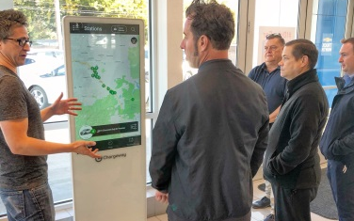
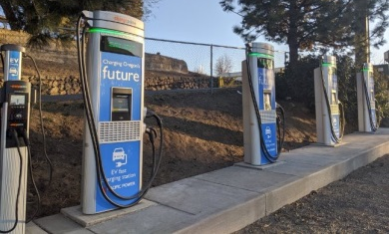
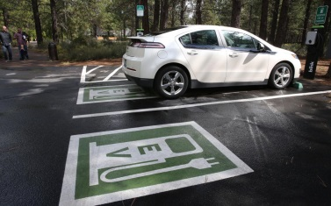
Electric Vehicle Programs
Outreach and Education Programs
Online EV Cost Calculator
Chargeway Beacon deployment
Technical Assistance
Pop-ups/tabling
Ride and Drives
Pacific Power Public Charging Stations
30 Public Fast Charging and Level 2 Stations:
  Bend
  Klamath Falls
  Madras
  Mill City
  Otis
Grant Funding
Grant funding to non-residential customers:
Infrastructure Charging Grant
E-Mobility Grant
Matching funds for external grants
CRuSe rural carsharing in Hood River

Slide 24
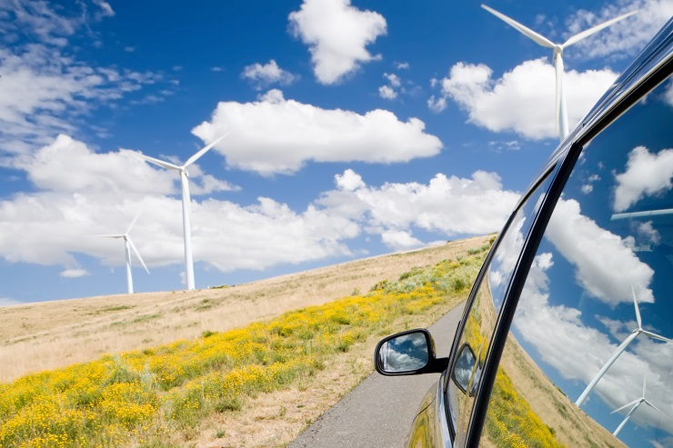
Electric Mobility Grant Funding Source
The Electric Mobility Grant is funded by the sale of Oregon Clean Fuels Program credits, which Pacific Power aggregates on behalf of residential customers who charge their electric vehicles at home
The goal of the Oregon Clean Fuels Program is to reduce greenhouse gas emissions from Oregon’s transportation fuels
Projects must benefit residential customers as a class

Slide 25
Available Funding
Estimated $650k in grant funding will be available
Funding awards will cover eligible costs associated with studying, planning, promoting, or deploying electric transportation technology and projects

Slide 26
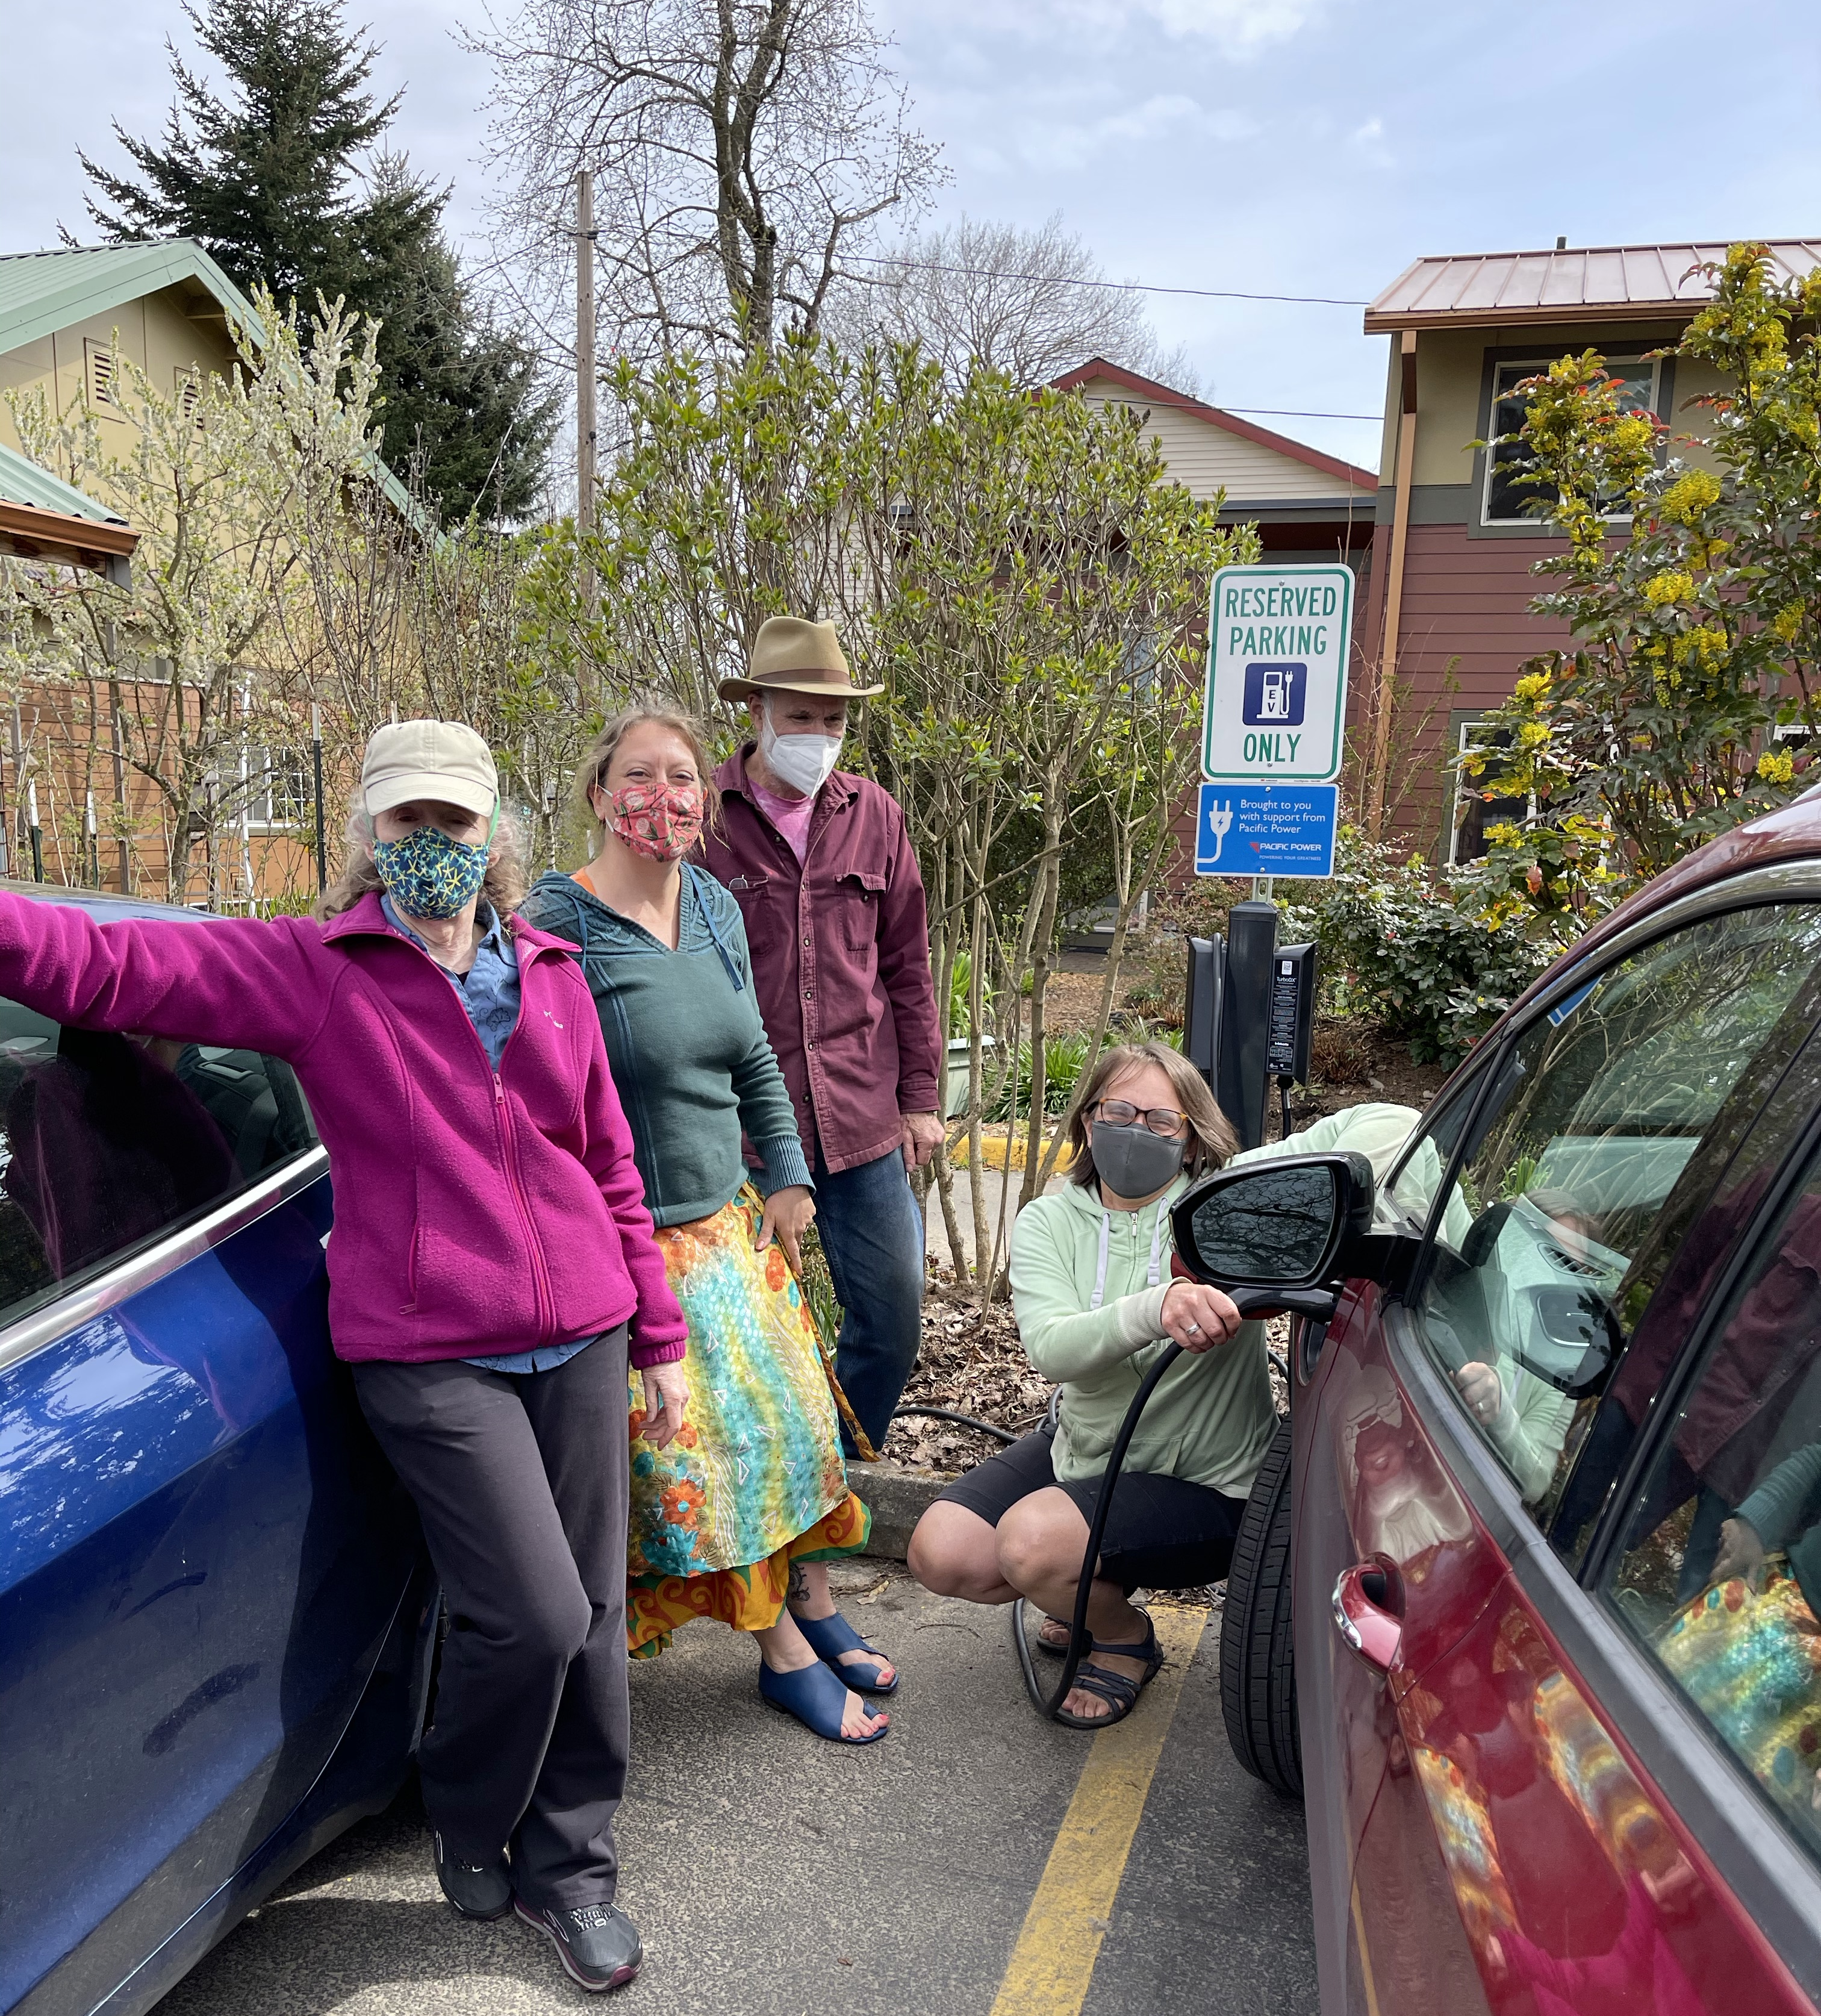
Eligibility
Pacific Power customers in Oregon on a non-residential electric service rate are eligible.
Specifically aimed to support:
  Non-profit organizations
  Government entities
  Small Businesses

Slide 27
Timeline
Step 1: Application Solicitation | Applications open June 1st
Step 2: Evaluation | Applications due August 31, 5pm PDT
Step 3: Selection and Notification | Applicants notified of grant award decision in October

Slide 28
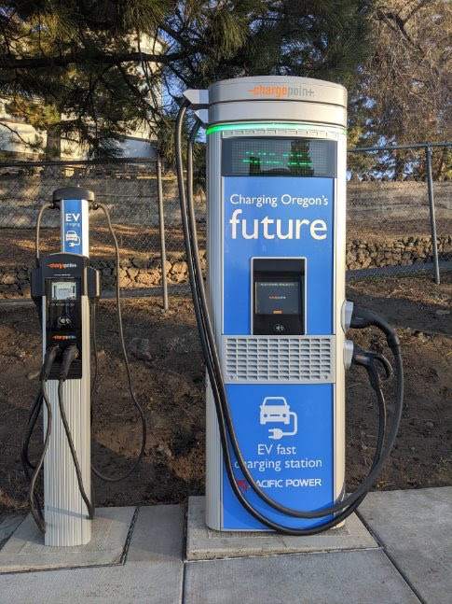
Technical Assistance
For infrastructure projects we can help you evaluate your options and costs with an on-site feasibility analysis.
Program Steps:
Submit application
Schedule a site visit
Receive technical assistance report

Slide 29
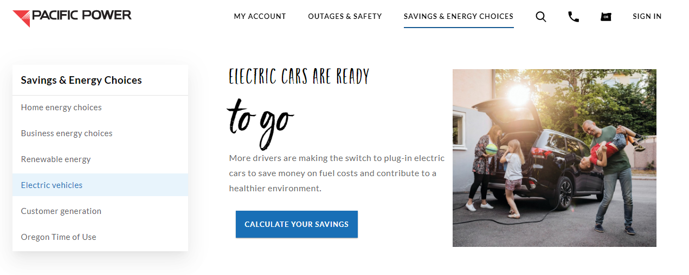
Electric Vehicle (EV) Homepage
www.pacificpower.net/ev

Slide 30
Questions
Contact: plugin@pacificpower.net

Slide 31
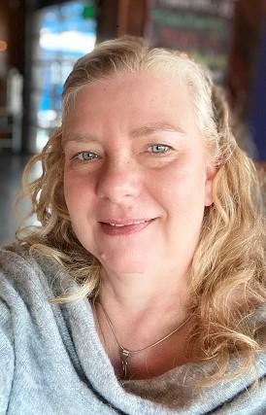
Next Up
Diesel Emissions Mitigation Grant
Angela Parker
Air Quality Planner
Oregon Department of Environmental Quality
Notes:
Angela Parker is a member of the team that has developed and is implementing DEQ’s new Diesel Emissions Mitigation Grants.

Slide 32

Diesel Emissions Mitigation Grant Program
Angela Parker
Air Quality Planner
Oregon Department of Environmental Quality
Notes:
In this presentation today we’ll be walking through DEQ’s new Diesel Emissions Mitigation Grant Program. This program is funded by the Volkswagen Environmental Mitigation Settlement Agreement and will reduce diesel emissions from older, more polluting, medium and heavy duty diesel trucks and equipment currently operating in Oregon. Our goal at DEQ is to establish a transparent and accessible program that measurably reduces diesel emissions in Oregon in the places where it’s needed most, pursuant to recent legislative direction. Today I’ll provide you with an overview of the program.

Slide 33
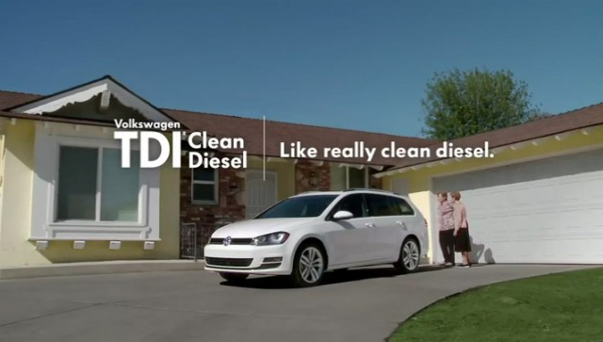
Diesel Emissions Mitigation Grant Program
Background
Oregon Department of Environmental Quality
Notes:
Since 2009, the Volkswagen Group of America sold diesel passenger cars in the United States with emission control defeat devices that violated federal emission standards. Software installed in more than five hundred and ninety thousand (590,000) vehicles that resulted in emissions of nitrogen oxides up to 40 times above the allowed limits. The resulting lawsuits were resolved in a partial Consent Decree, essentially a settlement against Volkswagen on behalf of the United States and vehicle owners. In addition to compensation for vehicle owners and mandatory investments in electric vehicle charging infrastructure, the decree requires Volkswagen to provide more than $2.9 billion to an Environmental Mitigation Fund to mitigate previous and current excess emissions of nitrogen oxides by these noncompliant vehicles. The initial allocation to the state of Oregon (based on registration share of VW diesels by state) is approximately $72.9 million to be spent over 10 years.
Based on legislative direction from 2017, DEQ is required to retrofit or replace at least 450 older diesel school buses across the state with our first portion of funding at a total expected cost of $18-22M. Oregon will have approximately $40M diesel settlement funds available for an expanded grant program after administrative costs and completion of our school bus project. Oregon must use all VW funds by October of 2027 or we’ll be forced to return unused funds. Our priority is getting older equipment off the road and out of our communities.

Slide 34
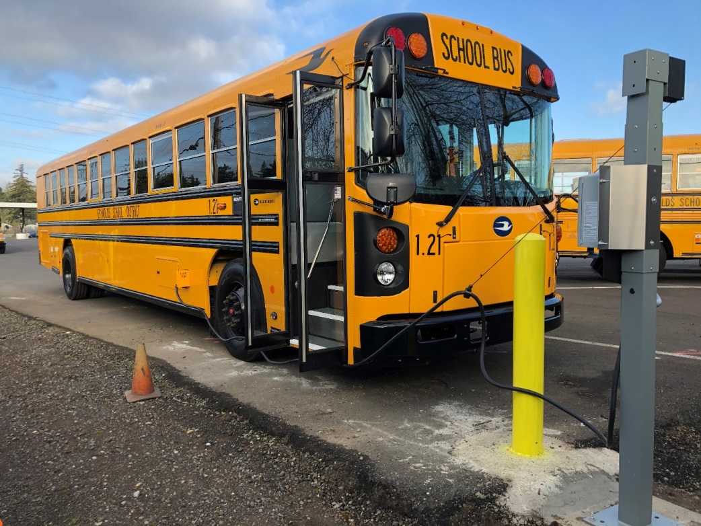
Diesel Emissions Mitigation Grant Program
School Bus Update
Oregon Department of Environmental Quality
Notes:
DEQ continues to help reduce diesel emissions in Oregon by funding local school systems that are replacing and retrofitting school buses. To date, DEQ has obligated and spent $8.8 million of funds from the Volkswagen Settlement to address 439 buses, reducing annual emissions by approximately 49.4 tons of harmful nitrogen oxides and 4.1 tons of carcinogenic particulate matter. The state is on track to replace or retrofit at least 450 school buses by the end of the year.

Slide 35
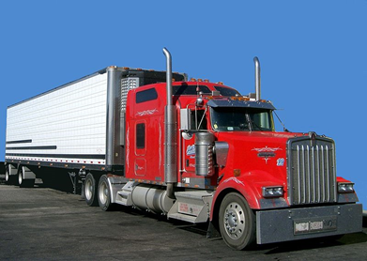
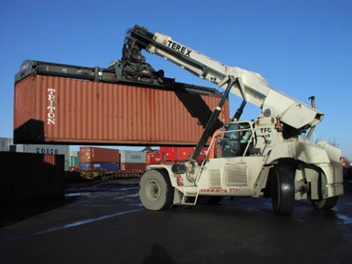
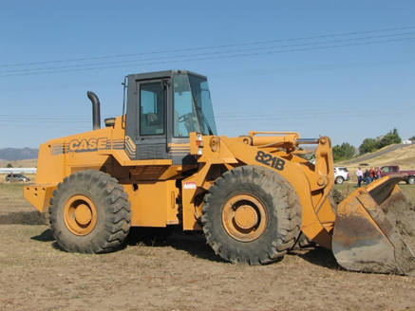
Diesel Emissions Mitigation Grant Program
Program Overview
Maximum reimbursement amounts (with exceptions) are:
100% for public sector projects and exhaust control retrofit
75% for all-electric equipment replacement
40% for engine repower
25% for private equipment replacement
Oregon Department of Environmental Quality
Notes:
Projects that are eligible for grant funding include the retrofit, repower, and replacement of older model diesel vehicles such as medium and heavy duty trucks, buses, nonroad equipment, ferries and tugs, locomotives, and generators. Projects from cities, counties, and public schools are eligible to receive reimbursement for 100% of equipment costs. Exhaust control retrofit projects on all types of equipment are also eligible to receive 100% reimbursement regardless of ownership. Gasoline powered vehicles and equipment, trucks and vans under 14,000 lbs are not eligible to receive funding under this program. Project eligibility is included in the proposed rules as established by the Environmental Mitigation Settlement and the related federal Diesel Emissions Reduction Act (DERA). Oregon will be allowed to fund projects with our settlement dollars as authorized under both of these programs.
In general the maximum reimbursement amounts (with exceptions) are:
100% for public sector projects and exhaust control retrofits
75% for all-electric replacement
40% for repower
25% for replacement
Each project must produce measureable diesel emissions reductions from equipment that is currently in regular operation.
- Explain this is a competitive grant early on

Slide 36

Diesel Emissions Mitigation Grant Program
Air Quality Project Detail
Replace a publicly owned diesel school bus with a new zero emission electric vehicle
Max reimbursement: 100% of equip.
Can match with other funding sources
New equip. must be equivalent to old
Old equip. must be based in Oregon
Project must reduce diesel emissions
Oregon Department of Environmental Quality
Notes:
(2) Eligible buses that are repowered with any new diesel or alternate fueled or all-electric engine or that are replaced with any new diesel or alternate fueled or all-electric vehicle, and using an engine model year in which the repowering or replacement occurs or one engine model year prior, are eligible for the following amounts of grant funding:
(b) For government owned eligible buses and eligible buses that are privately owned school buses under contract with a public school district, approved applications may receive a maximum reimbursement in the amount of:
(D) Up to 100% of the cost of a new all-electric vehicle, including charging infrastructure associated with the new all-electric vehicle.

Slide 37
Diesel Emissions Mitigation Grant Program
Application Process
Applicant Information
Who is applying for a grant funded project?
Project Description
What type of project will reduce diesel emissions in Oregon?
When will the project be complete?
Diesel Equipment Details
What type of diesel equipment is going to be addressed?
Project Costs
How much does the project cost?
Location Information
Where will the air quality be improved when the project is complete?
Oregon Department of Environmental Quality
Notes:
DEQ has established an online grant application platform called WebGrants (now available on our webpage) for everyone who wants to apply for funding under this program. The software will allow you to set up an account, input all required information, and save draft materials while applicants collect documentation and photos for their old diesel equipment.
Technical Assistance –
DEQ staff is supporting applicants in establishing fleet inventory and tracking requirements
DEQ has developed a comprehensive user guide as a resource for grant applicants (also available on our webpage)
A key feature unique to this program is the availability of funding, up to 15% of reimbursement maximums, for technical assistance services for COBID certified firms.

Slide 38
Diesel Emissions Mitigation Grant Program
Application Review Process
Among proposed projects that are eligible for funding, DEQ will give preference to projects that:
Support compliance w/ HB 2007 or contract specifications related to emissions standards for diesel engines
The applicant is a Disadvantaged, Minority, Women, or Emerging Small Business (DMWESB) or Service Disabled Veteran Business (SDVB)
Involve the replacement, repower or retrofit of equipment w/at least three years of remaining useful life
Support the utilization of fuels that generate credits under the clean fuels program
Oregon Department of Environmental Quality
Notes:
HB 2007, passed in the 2019 Oregon Legislature, establishes criteria DEQ will use to award grant funding. This direction is primarily focused on industry-specific benefits for owners of heavy duty diesel equipment, including those regulated by HB 2007. For example, it requires DEQ to prioritize projects led by disadvantaged, minority-owned, woman-owned, service-disabled veteran owned, and emerging small businesses. The cost effectiveness criterion is based on EPA’s Diesel Emissions Reduction Act or DERA program to increase emissions benefits with limited funding. The vulnerable population criterion is based on DEQ’s existing diesel mitigation plan and our commitment to prioritizing investments in communities that are disproportionately impacted by diesel pollution.

Slide 39
Diesel Emissions Mitigation Grant Program
Application Review Process
Among proposed projects that are eligible for funding, DEQ will give preference to projects that:
Benefit owner/operators of only one heavy-duty truck w/ fleet registered in Mult., Clack. or Wash. Co.
Benefit small fleets
Involve the retrofit of concrete mixer trucks or trucks that are used for the transportation of aggregate
Reduce diesel emissions in Oregon with the most cost effective projects
Reduce diesel emissions in areas of the state with the highest diesel emissions, highest vulnerable populations, and the highest population density.
Oregon Department of Environmental Quality
Notes:
DEQ will apply these criteria when reviewing applications and award grant dollars accordingly. Each applicant pool will be scored and ranked with highest scoring projects among all applicants in a given grant cycle receiving funding until all available grant dollars are spent. We will review projects based on project type, cost, air quality benefit, project location, applicant profile, and fleet profile. If available funds are oversubscribed and several applications receive the exact same score, DEQ will calculate detailed cost effectiveness amounts to break any tie. DEQ staff intend to review applications after August 31st (the grant deadline).

Slide 40
Diesel Emissions Mitigation Grant Program
Schedule
Estimated dates of grant application and deadlines, subject to change based on the timing and availability of funds and the schedule of implementation tasks.
Grant program opens for applications | 6/30/2021
Grant program closes for applications | 8/31/2021
Grant awards announced | 11/1/2021
Funding for projects becomes available | 1/15/2022
DEQ has published a comprehensive user guide to support applicants. Staff will provide technical assistance throughout the grant process to help everyone participate.
Oregon Department of Environmental Quality

Slide 41
Diesel Emissions Mitigation Grant Program
Funding Totals and Timeline for Implementation
Date Range | Activity | Fund Allocation | Funds Available
Oct. 2, 2017 | VW Settlement | $72.9M | $72.9M
2017-2027 | 15% Admin. | ($10.9M) | $62M
Aug. 15, 2017 | SB 1008 | ($18-22M) | $40 - $44M
Aug. 9, 2019 | HB 2007 | (Remaining VW Funds) | $40 - $44M
2021 | Grant Availability #1 | ($8M) | $32 - $36M
2022 | Grant Availability #2 | ($8 - $8.8M) | $24 - $26.4M
2023 | Grant Availability #3 | ($8 - $8.8M) | $16 - $17.6M
2024 | Grant Availability #4 | ($8 - $8.8M) | $8 - $8.8M
2025 | Grant Availability #5 | ($8 - $8.8M) | $0
2026 | Potential Grant Avail. | Based on remaining funds
2027 | Potential Grant Avail. | Based on remaining funds
Today
Oregon Department of Environmental Quality
Notes:
In 2021 DEQ will make approximately $8M settlement funds available. Our current plan is to open five consecutive grant rounds between 2021 and 2025 as detailed in this table.
Our estimates of available funding and proposed timeline for implementation are included here. As discussed previously DEQ is scheduled to receive a total of $72.9M, identified on the top line. Administrative expenses and technical services are expected to cost up to $10.9M and the school bus program is expected to cost between $18-22M. Oregon will have approximately $40M diesel settlement funds available for the total grant program addressed under today’s proposed rules.

Slide 42
Diesel Emissions Mitigation Grant Program
Program Website
https://www.oregon.gov/deq/aq/programs/Pages/Diesel-Grants.aspx
Technical Assistance
dieselgrants@deq.state.or.us
Oregon Department of Environmental Quality
Notes:
Webpage includes:
WebGrants platform to register and apply
User guide for applicant resource
Overview training recording
Rules reference
Fact sheet for overview
Other materials to be added include FAQs and other trainings

Slide 43
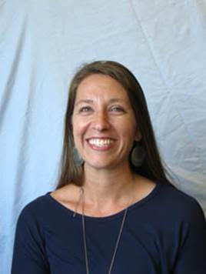
Next Up
Public Purpose Charge/ SB1149
Christie Sphoon
School Programs Lead
Oregon Department of Energy
Notes:
Christie Sphoon has served with Oregon Department of Energy for over 20 years. During this time she has held several different positions and has worked extensively with school districts since 2006. In her current lead role with the Schools Program, she focuses on work to implement energy efficient measures within schools. Christie also helps school districts navigate electric vehicle and electric vehicle charger purchases through the Schools Program.

Slide 44
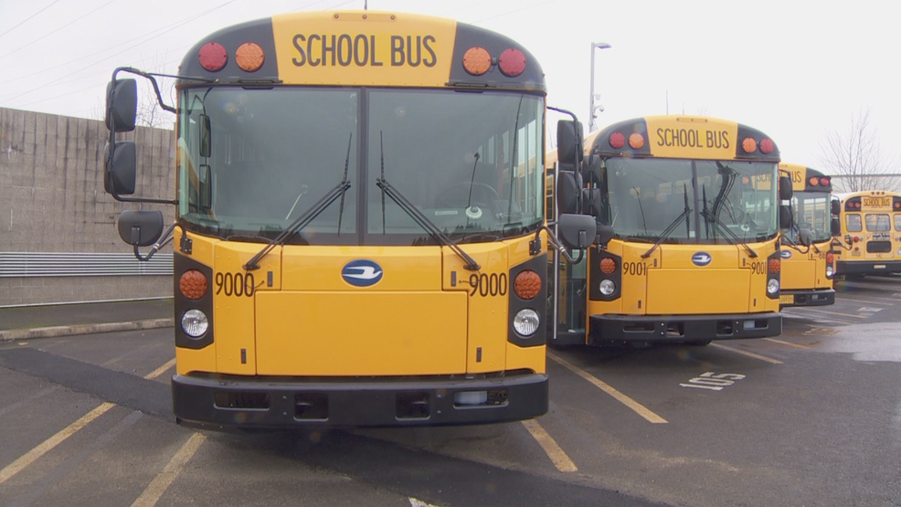

Oregon Department of ENERGY
Public Purpose Charge Schools Program – Electric School Bus Funding
Christie Sphoon
July 2021
Notes:
Introduction – Christie Sphoon, Schools Program Lead at OR Dept of Energy

Slide 45
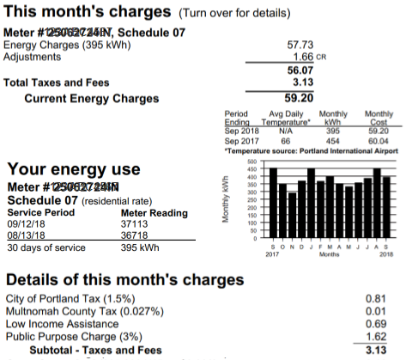
PUBLIC PURPOSE CHARGE (SB 1149)
SCHOOLS PROGRAM
Public Purpose Charge =
3% on Portland General Electric and Pacific Power customers’ utility bills
School Districts receive the first 10%
Energy Trust of Oregon receives just under 74%
Oregon Housing and Community Services receives just over 16%
Notes:
- PPC first assessed in 2002

Slide 46
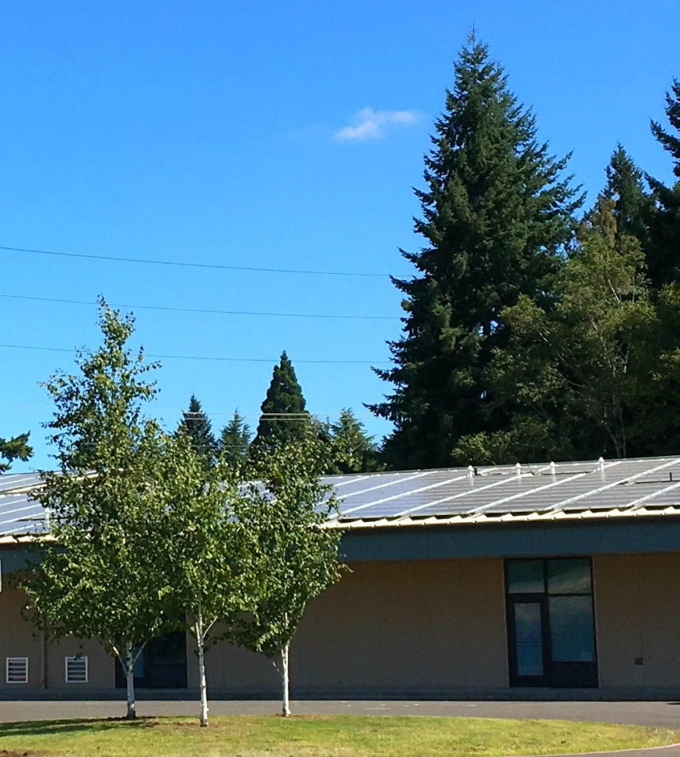
PUBLIC PURPOSE CHARGE (SB 1149)
SCHOOLS PROGRAM
Eligible Facilities:
  K – 12 Educational Facilities
    Owned by School District
    Within PGE or Pacific Power electric territory
Non-Eligible Facilities:
  New K – 12 Educational Facilities (within first 2 years)
  Administrative Facilities
  Facility/Maintenance Buildings
Notes:
- The eligible facilities and their associated student counts are what determine the District’s eligible percentage of PPC funds each year.

Slide 47

PUBLIC PURPOSE CHARGE (SB 1149)
SCHOOLS PROGRAM SUMMARY
# of Eligible School Districts: | 110
# of Eligible Schools: | ~ 825
Average Annual SB 1149 Funds: | $8 million
SB 1149 Funds Revenues 2002 to June 30, 2019: | Just over $137 million
SB 1149 Expenditures 2002 to June 30, 2019: | Just over $125 million
Notes:
- Basic info about the Program

Slide 48

PUBLIC PURPOSE CHARGE (SB 1149)
SCHOOLS PROGRAM
​Effective January 1, 2020, school districts may use Public Purpose Charge funds to complete a fleet audit, purchase or lease zero-emissions vehicles, including buses, and purchase or install electric vehicle charging stations.
​Fleet Audits, Electric Vehicles and Charging Stations
www.Oregon.gov/energy/energy-Oregon/pages/Public-Purpose-Charge-(SB-1149)-Fleet-Audits-Electric-Vehicles-and-Charging-Stations.aspx
Notes:
SB 1044 passed 2019 leg. session that incorporated the fleet audit and EV language.

Slide 49
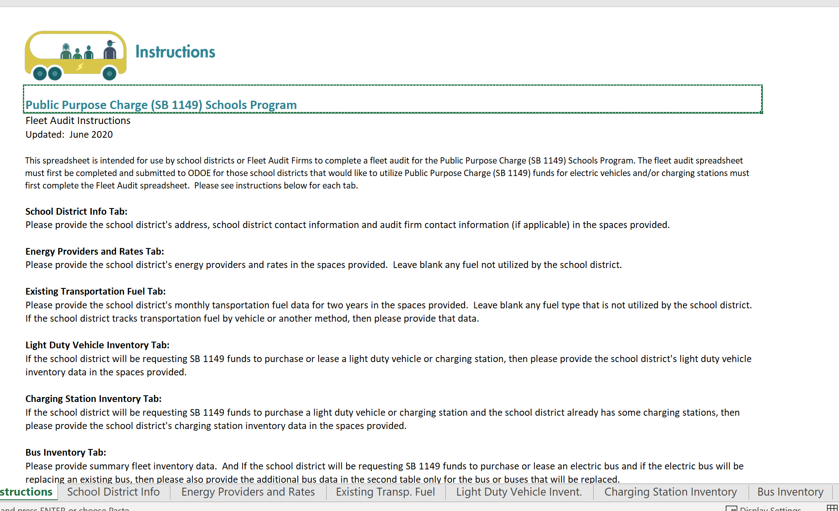
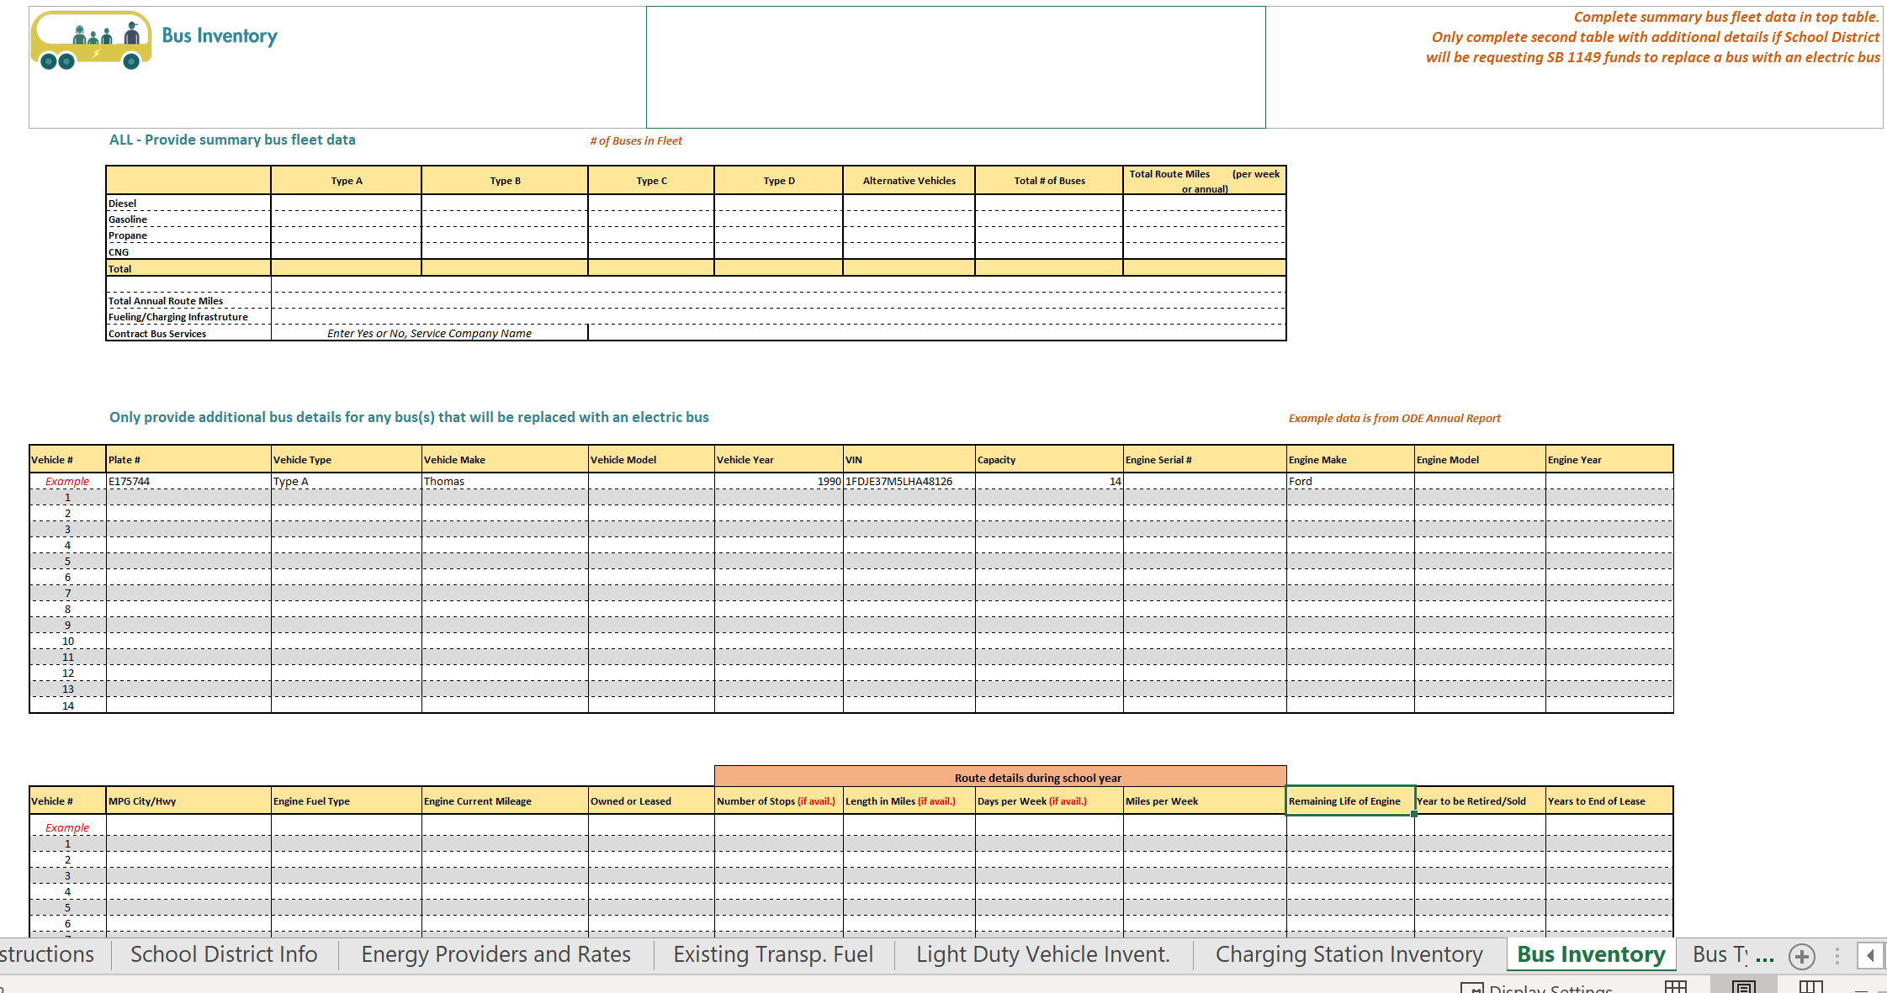
PUBLIC PURPOSE CHARGE (SB 1149)
SCHOOLS PROGRAM
* Discuss internally with School District Facility Manager and Business Manager if the School District has already allocated or spent out Public Purpose Charge funds on energy measures within the schools
* Complete and Submit Fleet Audit Spreadsheet

Slide 50
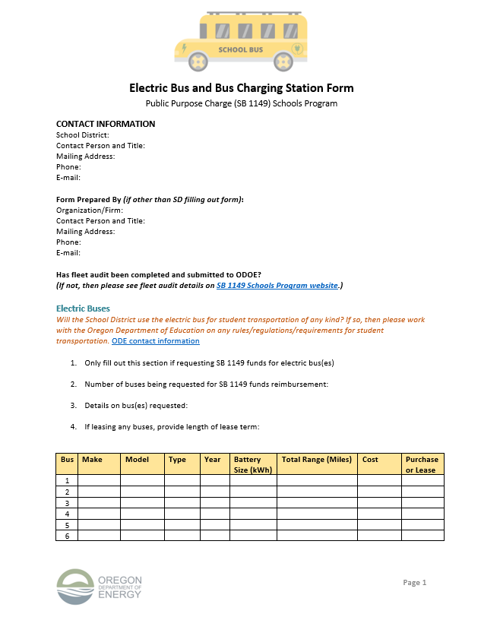
PUBLIC PURPOSE CHARGE (SB 1149)
SCHOOLS PROGRAM
* Complete and Submit Form for Vehicle/Charging station Type
* Lastly, submit Confirmation of Purchase/Lease to ODOE

Slide 51
PUBLIC PURPOSE CHARGE (SB 1149)
SCHOOLS PROGRAM
Public Purpose Charge (SB 1149) Funds for Electric Buses and Bus Charging Stations
SB 1149 eligible amounts are not considered approved for reimbursement until after the School District has completed the fleet audit, the Electric Bus and Bus Charging Stations Form and submitted receipts and final cost documentation requesting reimbursement to ODOE.
Bus Chargers
Up to 100% of charger cost to the School District for dedicated units to electric bus fleet minus any other grants or incentives
Electric School Buses
Type A Buses – up to $250,000 per bus.
Type C/D Buses – up to $300,000 per bus
  Not to exceed 100% of the total cost minus any other grants or incentives
Notes:
Eligible portions of funds

Slide 52
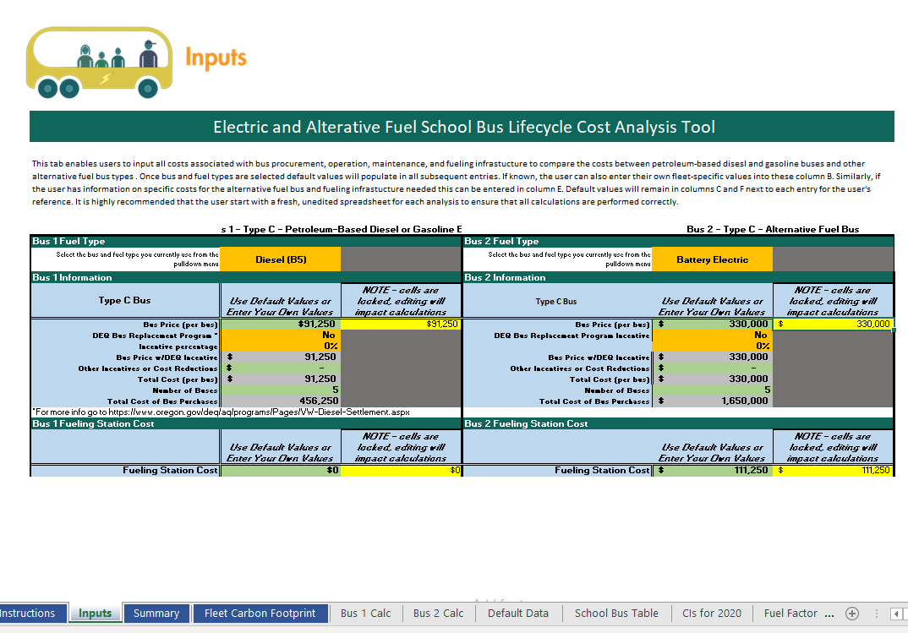
SCHOOL BUS TOOL
School Bus Cost Comparison Tool - Coming Out Soon!!!
Notes:
This is just to introduce the School Bus tool and that ODOE will reach out for training when its published.

Slide 53

PUBLIC PURPOSE CHARGE (SB 1149)
SCHOOLS PROGRAM
Thank You!
Schools Program Contacts:
Christie Sphoon, Christie.l.sphoon@energy.Oregon.gov, (503) 373-7430
Tracy Richardson, Tracy.richardson@energy.Oregon.gov, (503) 373-2294

Slide 54

Panel Discussion/ Q&A
Please ask your questions in the Q&A panel on your Zoom window

Slide 55
What is Next?
Recording and slides
Future events
One on One support
Site visits
Alison Wiley
Project Manager
Western and Southern Oregon
541-295-0255
alison@electricschoolbus.org
Neil Baunsgard
Project Coordinator
Central and North East Oregon
425-765-2602
Neil@envirocenter.org
Envirocenter.org/Electric-Bus
The Electric Bus Learning Project is brought to you by Pacific Power and the Oregon Clean Fuels Program

